Slide 1
Kaggle House Price Challenge Team Least Squares

Slide 2
Workflow
Insert Diagram

Slide 3
Machine Learning Models
Insert diagram
Linear Regression Based
Multi-Linear
Ridge Regression
Lasso Regression

Slide 4
EDA

Slide 5
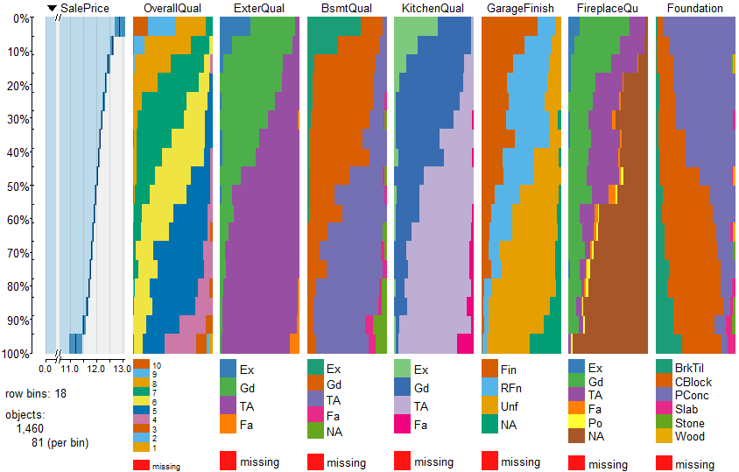
EDA - Categorical Vars

Slide 6
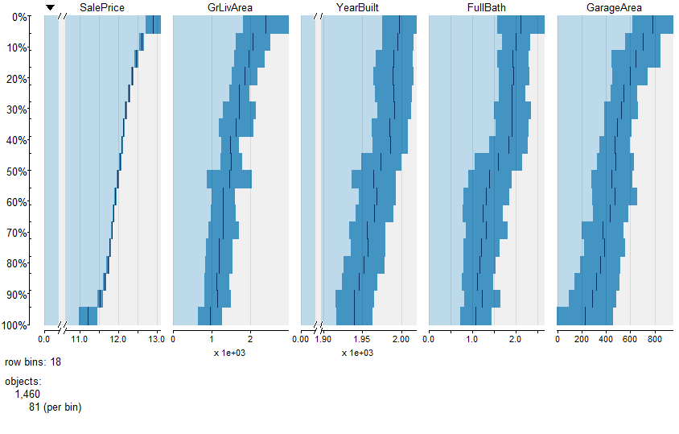
EDA - Continuous Vars

Slide 7
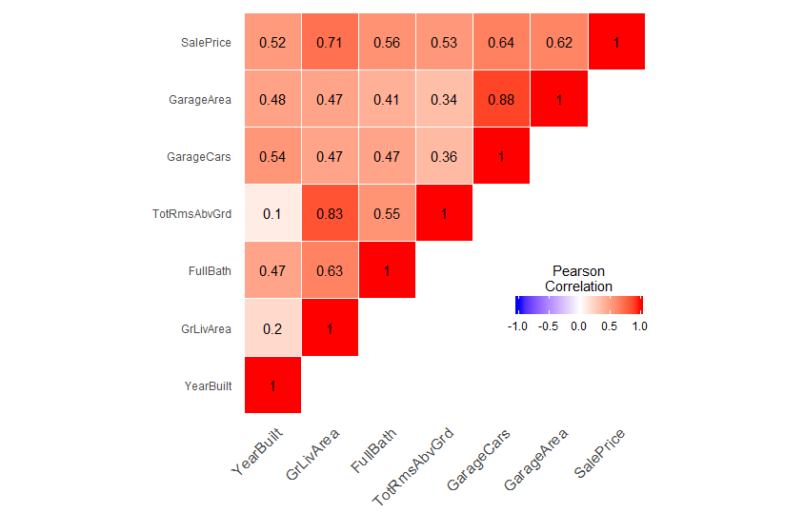
EDA – Correlation Plots

Slide 8
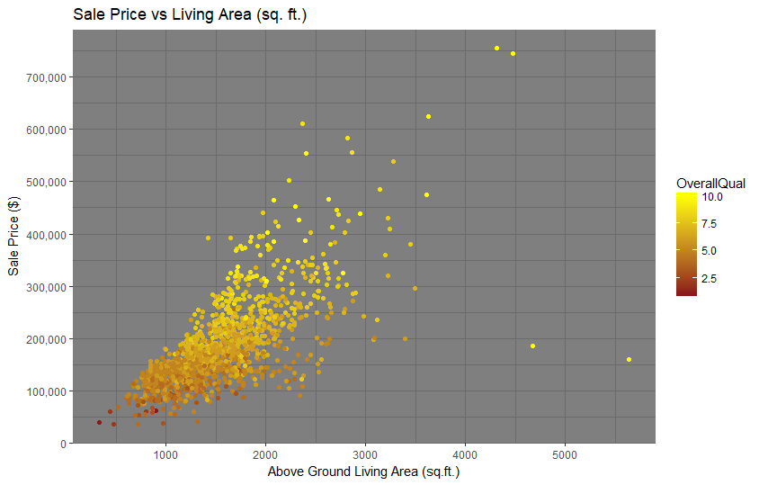
EDA - Scatterplot

Slide 9
Missingness
Categorical
Impute 'None'
Mode : Electrical
Continuous
Mean
Median

Slide 10
Feature Engineering
Outliers
Skewness
Scaled
Numerical=>Categorical

Slide 11
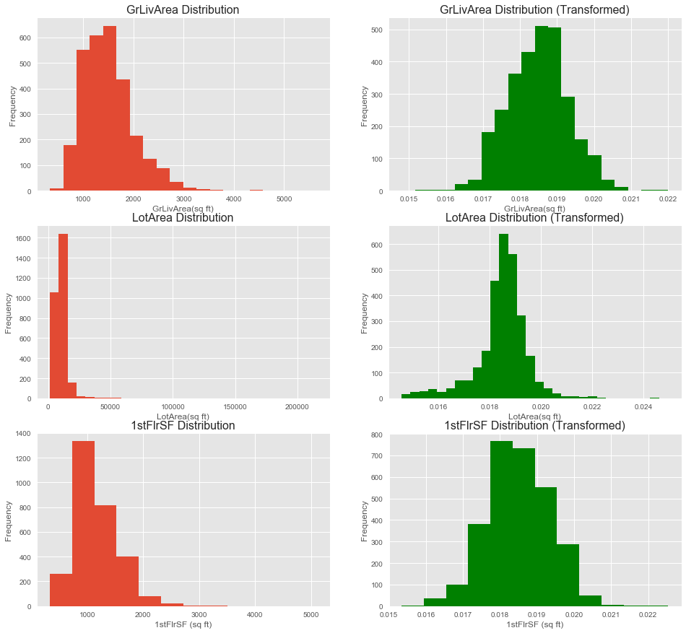
Feature Scaling & Skewness

Slide 12
Linear Models
Worked with Shortlisted 20
Categorical Grouped into Quartiles
Neighborhood
Overall Quality
Table of VIF

Slide 13
Linear Model (cont.)
Influence Plot

Slide 14
Linear Model (cont.)
Residual Plot

Slide 15
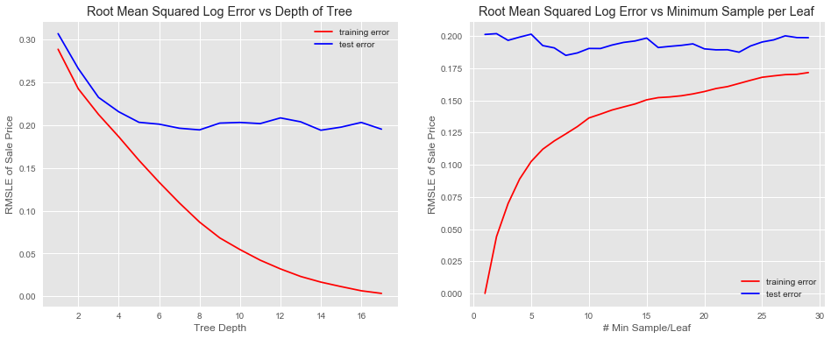
Decision Trees

Slide 16
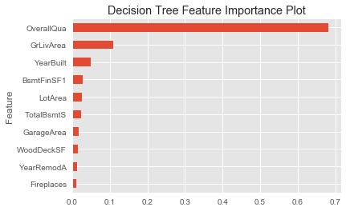
Decision Trees

Slide 17
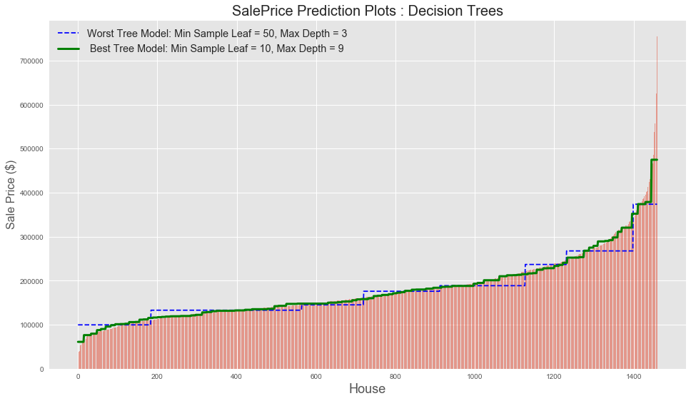
Decision Trees

Slide 18
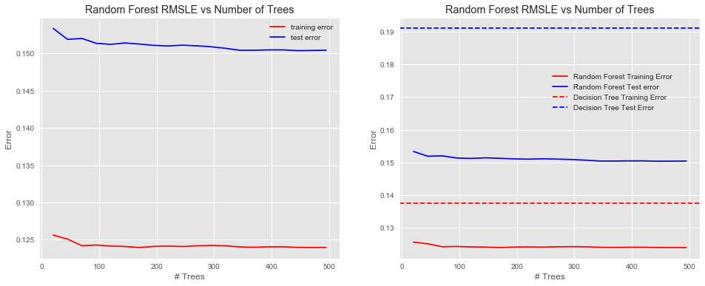
Random Forest

Slide 19
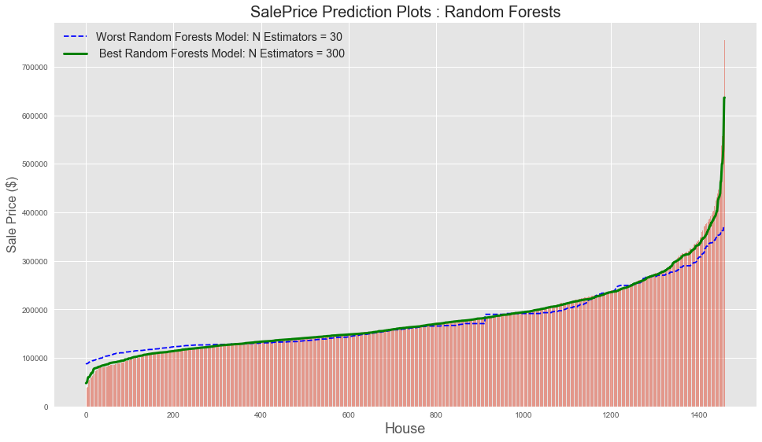
Random Forests

Slide 20
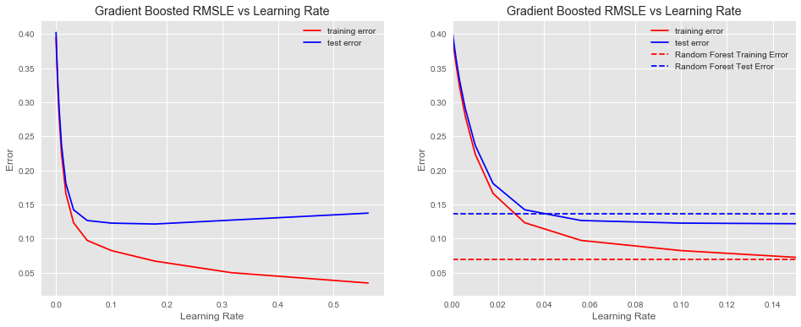
Gradient Boosting

Slide 21
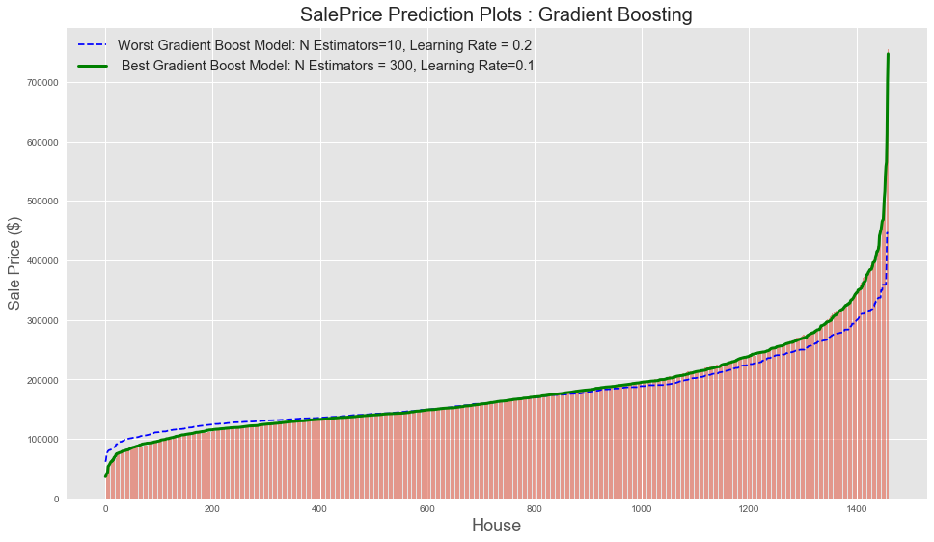
Gradient Boosting

Slide 22
CV Grid Search

